Slide 1

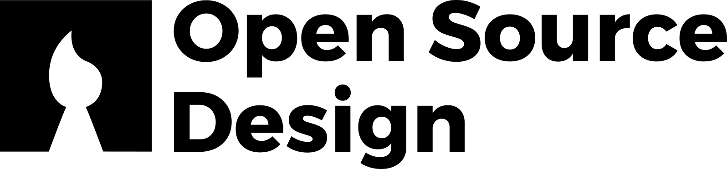
You Don’t Need to Be a Designer to Design: Fixing UX in Open Source
Archita Gorle
UX Designer, Canonical
01.02.2026
Confidential

Slide 2
Why are there fewer UX designers contributing to Open source projects compared to commercial tech?
Confidential
Notes:
This is a question that’s been around for a long time in the open source community.
Many of you here have probably seen blog posts, discussions, and panels around this exact topic.
I want to start by acknowledging that this conversation already exists and it matters.

Slide 3
Important work is already happening
Advocating for design in OSS
Improving contribution process
Lowering barriers for designers
Confidential
Notes:
Many designers (especially many familiar faces here in this room) have already been doing a lot of hard, necessary work here :
making the case for why UX matters,
Working on improving the design contribution process
creating better ways for designers to contribute,
and pushing design forward in open source.
This work is valuable, and it’s moving things in the right direction.

Slide 4
We don’t need to debate this anymore
UX matters in open source
Notes:
I also think we’re past the point of needing to convince people that UX matters.
Most maintainers and contributors already care deeply about their users.
That awareness is changing — and that’s a good thing.

Slide 5
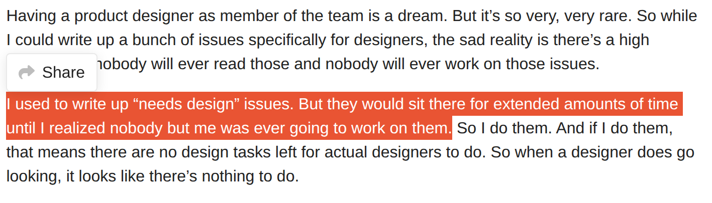
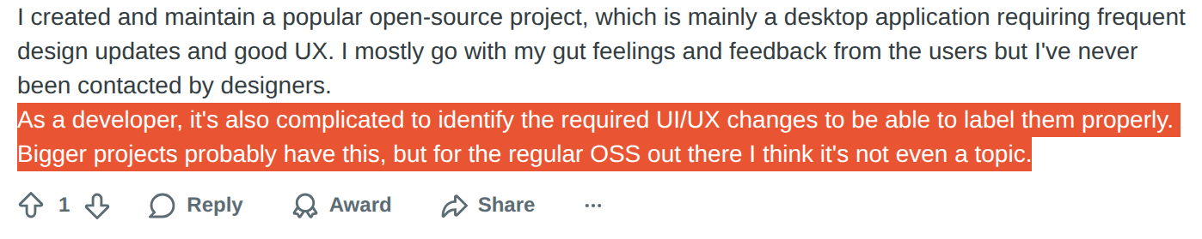
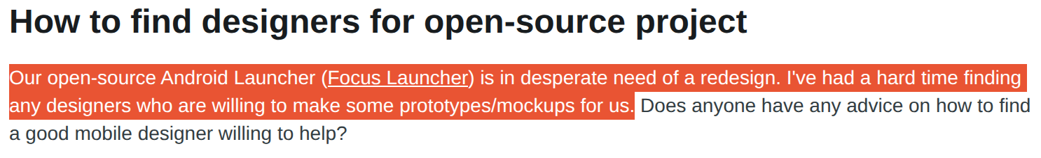
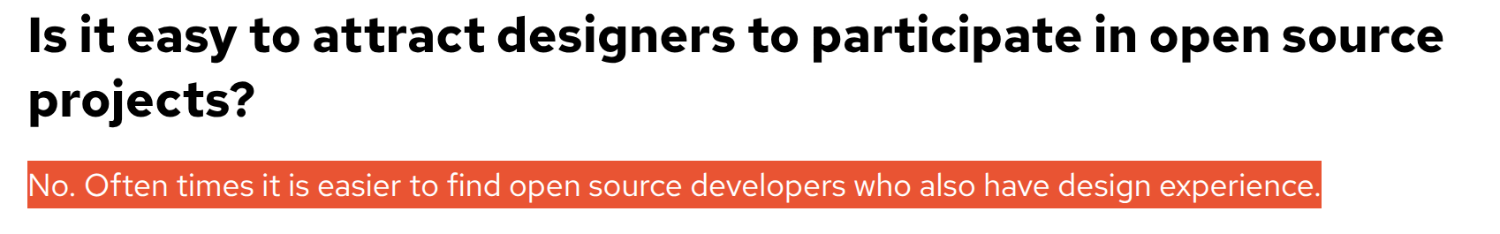
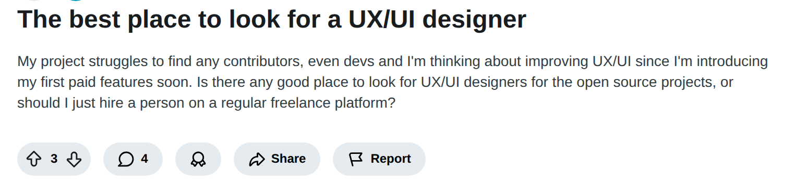
Open Source Design
Reddit:https://www.reddit.com/r/opensource/comments/pp6tx9/how_to_find_designers_for_opensource_project/
https://www.reddit.com/r/web_design/comments/1cxm7x9/where_can_i_contribute_to_open_source_ux/
https://www.reddit.com/r/opensource/comments/1jdr700/the_best_place_to_look_for_a_uxui_designer/
https://opensource.com/life/15/9/ato-interview-garth-braithwaite
Notes:
But then if you’ve spent any time in open-source forums or GitHub discussions, you’ve probably seen messages like these.
Maintainers noticing usability problems but not having a designer around to help.
These are not rare cases, they’re everyday open-source realities.

Slide 6
Reality check
The ideal: every project has a designer. The reality: most don’t, yet! Good UX shouldn’t depend on whether a designer is available.
Confidential
Notes:
In a perfect open-source world, every project would have designers and developers building side by side.
But the reality is — most projects don’t. You’ll often see a long list of UX issues and just one maintainer juggling everything.
It’s not that people don’t care about design — it’s that most open-source projects are volunteer-driven and developer-led, and there simply aren’t enough UX designers to go around, yet!
And, Good UX shouldn’t depend on whether a designer is available.

Slide 7
Every project having dedicated UX support won’t happen overnight
the ideal situation takes time
Notes:
At the same time, if we’re being realistic,
getting to a place where every open source project has dedicated UX support
is going to take time.
And while we wait for that future…

Slide 8
UX issues don’t pause
Users get stuck
Docs confuse
Features go unused
Notes:
UX issues don’t pause just because there isn’t a designer available.
Users still struggle.
Documentation still confuses.
Good features still don’t get adopted.
And ignoring those problems usually costs more in the long run.

Slide 9
Have you ever thought… "I see the problem, but I'm not a designer"
Confidential
Notes:
As a UX designer, I work every day with developers, engineering managers, product managers - and I see the same thing again and again: everyone genuinely care about how people experience what they build.
So when someone says ‘thinking about users is the UX designer’s job’, I never quite believe it.
Because every good developer I’ve met already does that — just through a different lens.
You already think like designers — maybe you just call it problem-solving.

Slide 10
Why believe me?
I’m a UX Designer.
I’m also an Engineer.
Confidential
Notes:
And why should you believe what I say?
Because…yes, I am a designer!
But more importantly because, I wasn’t always one. I’m also an engineer — with a bachelor’s and master’s degree in engineering.
And I believe I’m a better designer because I started as an engineer.

Slide 11
Engineering taught me how to solve problems. But, UX taught me to understand who I’m solving them for, and why.
Confidential
Notes:
Engineering taught me how to solve problems. UX taught me to understand who I’m solving them for, and why.
So when I first learned UX design, I realised it wasn’t an entirely new skillset — but it was definitely a new way of looking at problems.

Slide 12
What if developers (and non-designers) could surface and improve UX issues progressively and intentionally when no designer is around?
Confidential
Notes:
So today, I want to offer a parallel perspective:
Instead of leaving UX problems untouched when no designer is around, what if we fixed them progressively and intentionally?
What if contributors, developers, maintainers, people already passionate about the project — could surface UX issues or even better, fix some of those UX issues themselves?

Slide 13
UX is a Shared Responsibility
UX is not owned by designers. It’s improved by everyone. Designers still bring deep expertise. Developers bring context, constraints, and real-world signals.
Confidential
Notes:
UX is a Shared Responsibility
When everyone in the project can spot friction and improve it, the whole community wins.
Design isn't a credential, it's a skill anyone can practice.
Shared responsibility doesn’t mean everyone does the same work.
It means everyone can contribute.
Designers still bring deep expertise.
Developers bring context, constraints, and real-world signals.
When more people can spot friction early,
UX improves faster — and with less rework.

Slide 14
UX Design
is not just a role
Confidential
Notes:
That’s why I want to break UX down today —
not as a role, or a title,
but as a process and a practice.
Something developers and non-designers can use
to move things forward.
First, let’s see how misunderstood UX design often is

Slide 15
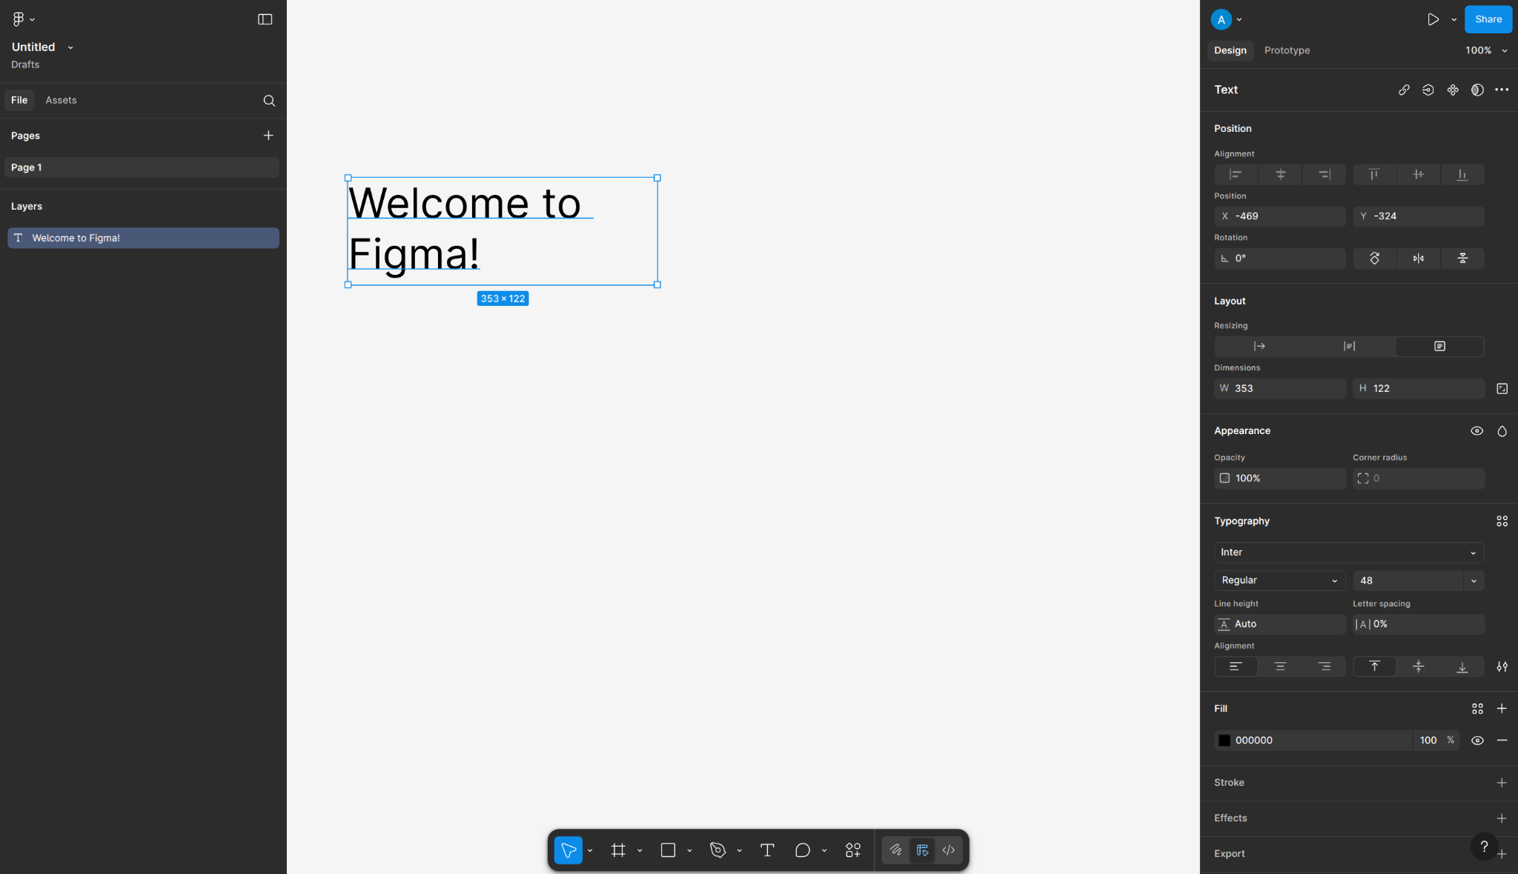
UX Design ≠ Figma
Confidential
Notes:
UX Design is not design tools!
UX design starts way before you even open Figma.
It starts when you notice that someone couldn’t finish a task, what they set out to do. In true open source spirit, if you’re a project maintainer, UX start when you notice that someone got confused in your README.

Slide 16
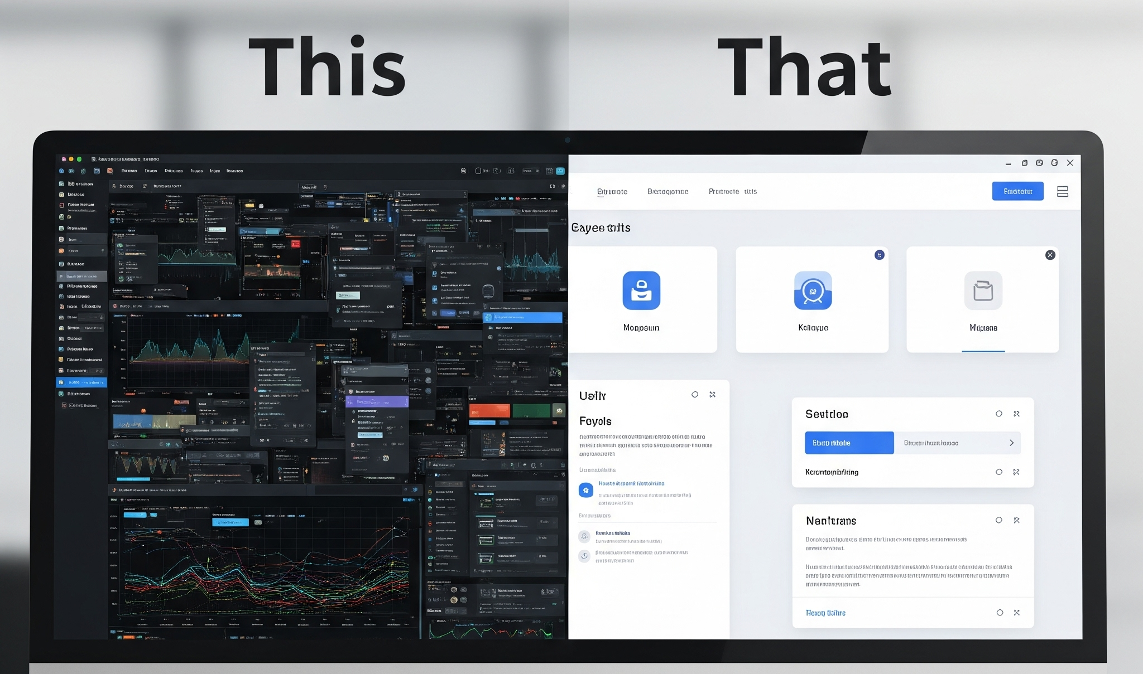
UX Design ≠ Making things pretty
Confidential
Notes:
Another big misconception — UX design is NOT about making things look beautiful.
Pretty is nice, but useful is better.
The real goal of UX isn’t to decorate your interface, it’s about making sure people can actually use it — without frustration, confusion, or giving up halfway.

Slide 17
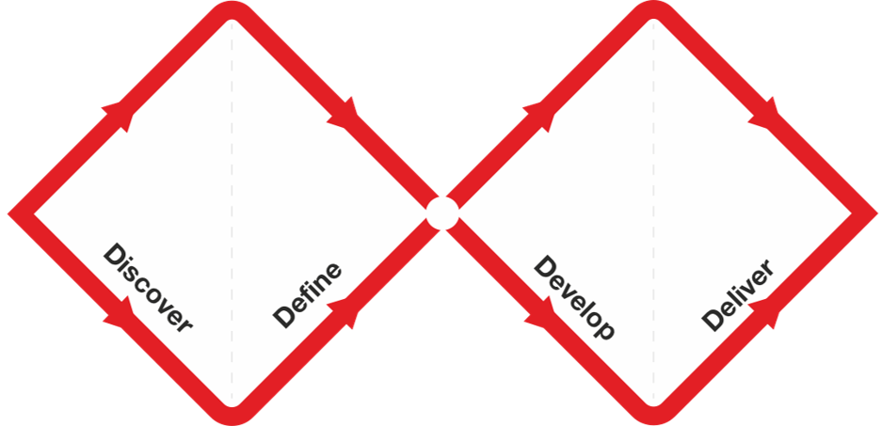
UX Design ≠ Fancy frameworks
The Double Diamond by the Design Council is licensed under a CC BY 4.0 license.
Confidential
Notes:
And finally — UX design is NOT Fancy frameworks, It isn’t some secret, complex process that only trained designers can follow.
You’ve probably seen this before — the Double Diamond.
It looks complicated, but it’s really just four simple ideas:
Discover, Define, Develop, and Deliver.
You don’t need a UX degree to do that — it’s exactly how good problem-solving works, whether you’re writing code or designing interfaces

Slide 18
UX Design is…
understanding what people are trying to do, and improving how they do it.
Confidential
Notes:
So now that we know what UX design is not, let’s look at what it is — and how you can start doing it right inside your open-source projects.
UX Design is understanding what people are trying to do, and improving how they do it.
That’s it. That’s the core of UX design.
For the purpose of simplifying it, I’d say you just need to remember two words — understand and improve.
Let me show you how you can do both — in the next parts, I’ll help break these 2 words further down into simple things for your to remember and apply.

Slide 19
Understand
the Problem
Confidential
Notes:
So we begin, with trying to understand the problem. This can be done in a few easy steps to start with.

Slide 20
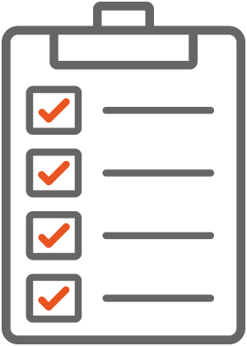
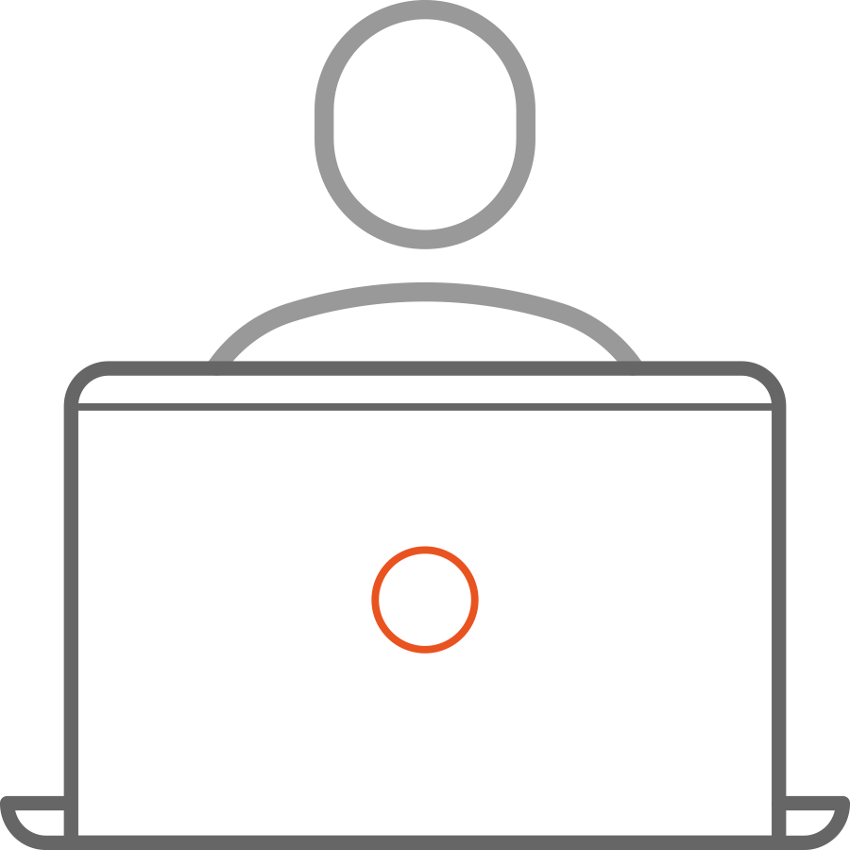

Observe
 | Watch someone new try your project.
 | Read GitHub / forum threads.
 | Keep a list of “UX Bugs.”
Even 10 minutes watching one person is worth more than 10 hours of guessing!
Confidential
Notes:
The first is to observe, where people get stuck. You don’t need fancy research tools — just watch someone new try to use your project. A friend, a contributor, or even your partner who doesn’t code. Give them your install instructions and… stay quiet. It’s painful, but educational.
You’ll see them pause, scroll back, reread something — that’s where the friction is.
Now, as a UX designer, I’d normally spend some days or weeks doing proper user research — interviews, usability tests, the full process.
Most times in open source, things move fast and people contribute when they can, especially in volunteer-driven projects.
So we don’t always have someone doing dedicated UX research — and that’s normal.
It just means the UX methods that work best here are the lightweight ones anyone can run.
It’s not perfect, but it’s practical.
Even 10 minutes observing one real user behaviour gives you more insight than 10 hours of guessing

Slide 21
2. Ask WHY? (Until It Hurts)
Problem
Why?
Why?
Why?
Root cause
Quick Method: Ask “Why?” 3–5 times to find the real problem.
Example:
“ Users fail at setup → why? → they skip step 2 → why? → it’s buried in long text → why? → docs lack structure.”
Confidential
Notes:
Once you spot a problem, don’t jump into fixing it yet.
Ask why — a few times.
Think of it as debugging human behaviour.
Keep asking why until you uncover the real issue, not just the surface symptom.
This comes from Toyota’s classic 5 Whys method.
And honestly — if you were that kid who asked too many questions… this is your moment to shine.

Slide 22
3. Talk to (a few) users
Quick method: Ask just these 3 questions:
What are you trying to do?
What’s easy or hard?
When did you last get frustrated?
“
Even 5–7 users can reveal ~80% of key usability issues.
Jakob Nielsen,
Nielsen Norman Group
Confidential
Notes:
You don’t need a full research study — just a few real conversations.
Ask them what they’re trying to do, what’s easy or hard, and when they last got frustrated.
Now, in proper UX research, we usually care a lot about things like statistical significance — making sure results are backed by data from dozens of users.
But this quick approach isn’t about replacing that.
It’s about noticing patterns.
you’ll often find that after talking to just 5 to 7 users, you’ve already uncovered about 80% of the major usability issues.
So even these small conversations can give you huge insight.

Slide 23
4. Define clearly
A good UX problem statement looks like:
“New users can’t complete setup because the instructions are long and unclear.”
A bad UX problem statement looks like:
“We need a new installer.”
Quick method: Use the format
“Who is struggling, with what, and why?”
Confidential
Notes:
Once you’ve understood the problem, define it simply.
This is where most people jump straight to solutions — like ‘we need a new installer.’ But that’s not a problem statement, that’s already a fix.
A good UX problem statement describes who is struggling, with what, and why — like ‘New users can’t complete setup because the instructions are long and unclear.’
If you can say your problem in one breath, you’re focused enough to start designing. If not, you probably need to understand it a bit more.

Slide 24
II. Improve
the Solution
Confidential
Notes:
Now, the most exciting and fun part!

Slide 25
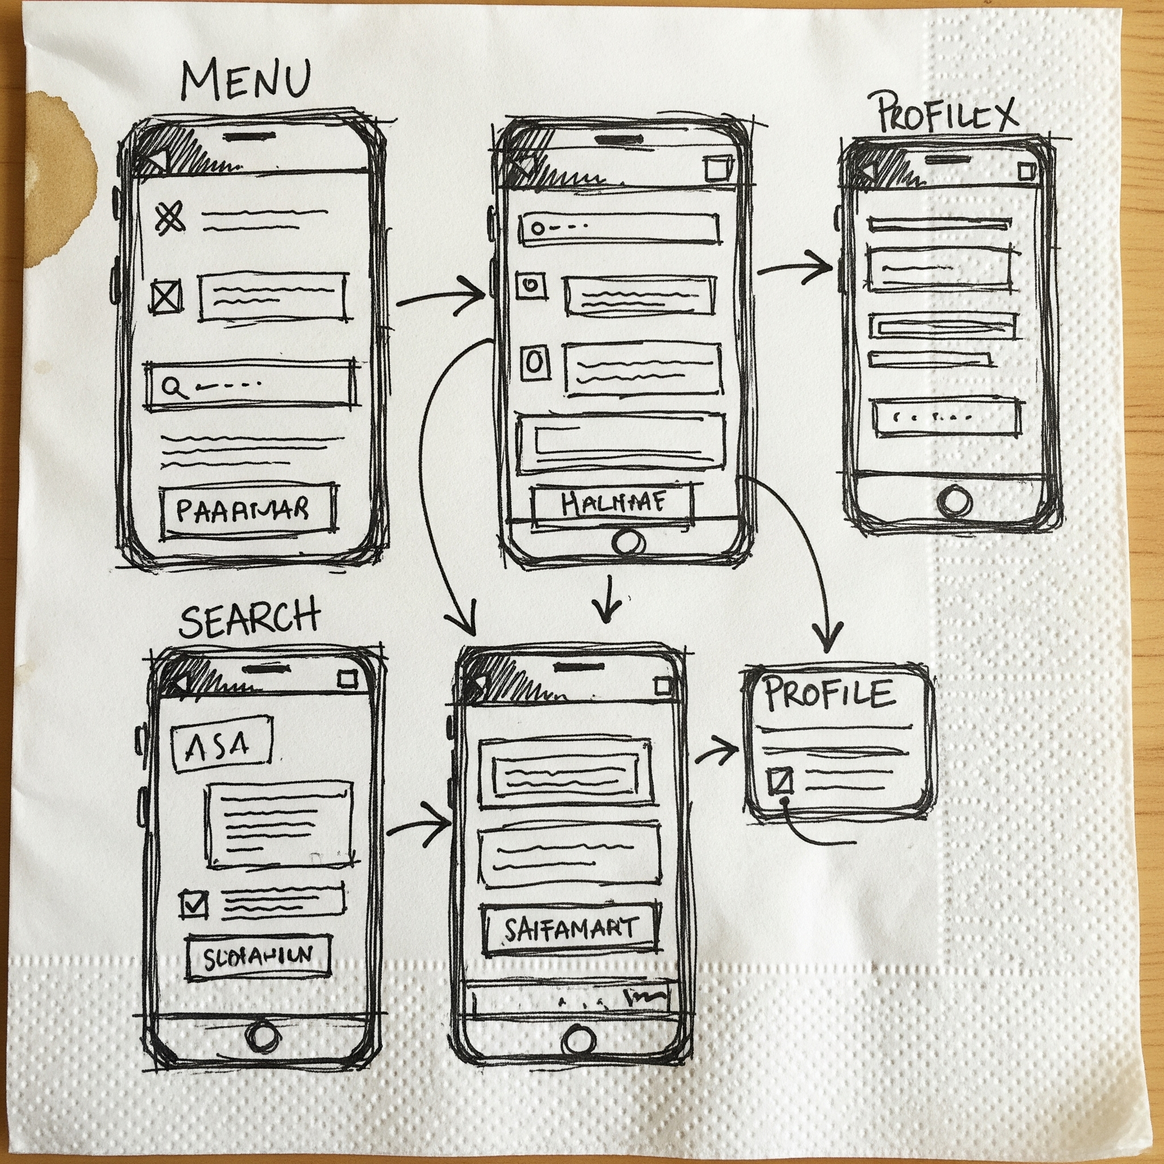
Draw
You don’t need Figma. Just draw. Boxes. Arrows. Labels. Share it in the issue. Start the conversation.
Quick method: Pen & Paper
Confidential
Notes:
Ideas. Starting with Sketch.
Just because it says ‘Sketch’ don’t be afraid, it doesn’t mean in artistic way.
You don’t need Figma. You don’t even need PowerPoint.
Grab a pen and paper. Draw boxes, arrows, and labels.
Stick figures are welcome.
You can share ideas in the issue within your repo, and start the conversation.

Slide 26

The Crazy 8s
8 Minutes 8 Ideas
Confidential
Notes:
If you want to go a bit further, try something called Crazy 8s.
Fold your paper into 8 boxes, and sketch 8 ideas in 8 minutes.
You’ll be surprised how creative your brain gets under pressure.

Slide 27
Share & Test
You don’t always need a prototype to test. You just need an idea people can react to.
Confidential
Notes:
Testing isn’t about polished screens — it’s about validating thinking.
A sketch, a flow, a sentence… all of these are testable
You don’t always need a prototype to test.
You just need an idea people can react to.

Slide 28
The 1-Minute Usability Test
1 Task
1 User
1 Minute
Confidential
Notes:
Here’s a super quick testing method: the 1-minute usability test.
Give one user one task and one minute — and just watch.
No hints, no explanations.
Where they pause or hesitate — that’s your UX bug.
It’s fast, lightweight, and perfect for open source.
Do this with min. 3 people from your community. Patterns emerge fast. That's validation.

Slide 29
Who is a ‘Real’ user?
Look for people who:
Use or want to use your project Match the skill level of your target audience Have fresh eyes
New users are gold!
Confidential
Notes:
People around you are the lowest- friction audience
Look for people who:
Use or want to use your project
Match the skill level of your target audience
Have fresh eyes
Newbies are your best test users because they see issues/ friction experts can’t.

Slide 30
Iterate
Fix
Test
Repeat
Progress > Perfection
Confidential
Notes:
Keep making small fixes and running quick tests — a simple repeat cycle — until the solution feels clear and effortless for your users.
Think of this like fixing bugs — rarely solved in one commit. Remember , progress > perfection!

Slide 31
Document the Why → Keep the Learning
Good UX work multiplies when shared.
Write down:
The problem you saw What you tried What changed
Confidential
Notes:
UX improvements shouldn’t disappear into commit messages.
Add it to your project’s wiki, design doc, or issue notes.
It helps others repeat the process — and keeps UX alive in the repo.
Add a label like ‘UX improvement’ so contributors see UX as part of the project’s DNA.

Slide 32
UX toolkit
Observe & Ask Why → understand Define Clearly → focus Sketch & Share → propose and discuss Test & Document → improve and spread
Confidential
Notes:
So here’s your UX toolkit — and none of it requires Figma or Photoshop!
You can think of it like debugging, but for people.
You find the bug — the friction — trace the cause, fix it, and test again
And that’s UX design in the simplest form.
You don’t need to be a designer to do it — just curious enough to understand, and brave enough to improve.

Slide 33
But here's the magic…
When developers and designers collaborate, impact multiplies!
Confidential

Slide 34
Collaborate
Confidential

Slide 35
What developers can do
When a designer is around, what helps designers help you:
Surface friction early
Add context, not solutions
Show constraints
Confidential
Notes:
When designers join a project — or drop in briefly —
what helps them most isn’t perfect wireframes.
It’s:
Surfacing friction early
Don’t wait until users are angry or leaving.
Small confusions matter.
Adding context, not solutions
What was the user trying to do?
Where did they get stuck?
Why does it matter?
Showing constraints
Technical limits, timelines, backwards compatibility —
this context makes design proposals realistic and faster.

Slide 36
What designers can do
How designers can multiply their impact in open source
Enable early signals
Lower the bar to contribute
Turn dev insights into UX wins
Make “UX thinking” contagious
Confidential
Notes:
In open source, designers rarely have the luxury of owning an entire product end to end.
So impact doesn’t come from polishing pixels — it comes from enabling the system.
Designers can:
Enable early signals: Help contributors recognize UX issues earlier — before they turn into long GitHub threads or frustrated users.
Lower the bar to contribute: simple UX checklists, “what to look for” guides — these help non-designers spot and report problems better.
Make “UX thinking” contagious: When designers explain how they think — not just what they propose —contributors start asking better questions themselves.
Over time, maintainers begin to spot UX issues earlier, and that’s when impact scales.

Slide 37
You don’t need permission to improve UX
Start small. Be intentional. Improve together.
Confidential
Notes:
You don’t need a title to care about users.
You don’t need perfect conditions to improve UX.
If we treat UX as a shared responsibility and collaborate intentionally, open source can build products that are not just powerful, but genuinely usable.

Slide 38
Thank you!
Questions? Let's talk.
Confidential

